Slide 1

Geometry
Unit 9, Lesson 10 Determining How Dilations Affect Area Volume 2, pg. 104

Slide 2


Benchmark
MA.912.GR.4.3
Extend previous understanding of scale drawings and scale factors to determine how dilations affect the area of two-dimensional figures and the surface area or volume of three-dimensional figures.
volume 2, pg. 104

Slide 3
Integrated Mathematical Thinking and Reasoning Standards
MA.K12.MTR.1.1 Actively participate in effortful learning both individually and collectively.
MA.K12.MTR.4.1 Engage in discussions that reflect on the mathematical thinking of self and others.
MA.K12.MTR.5.1 Use patterns and structure to help understand and connect mathematical concepts.
MA.K12.MTR.6.1 Assess the reasonableness of solutions.
volume 2, pg. 104

Slide 4

Learning Target
I can discover the relationship between area and the scale factor of a dilation.
volume 2, pg. 104

Slide 5

Warm-Up
volume 2, pg. 105

Slide 6
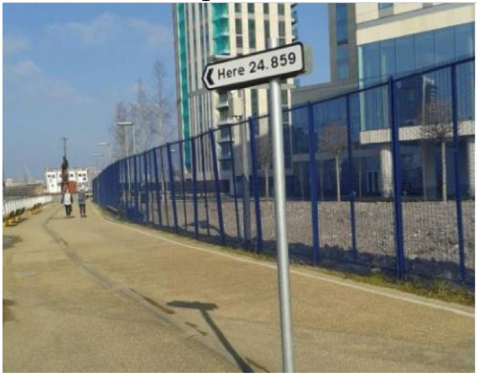
9.10.1 Warm-Up: Where is Here?
A picture of a directional sign is shown.
What do you notice about the sign?
Where do you think the picture was taken?
The Earth’s average polar circumference is 24,859 miles. What do you think the sign means?
volume 2, pg. 105

Slide 7

Exploration
volume 2, pg. 105

Slide 8

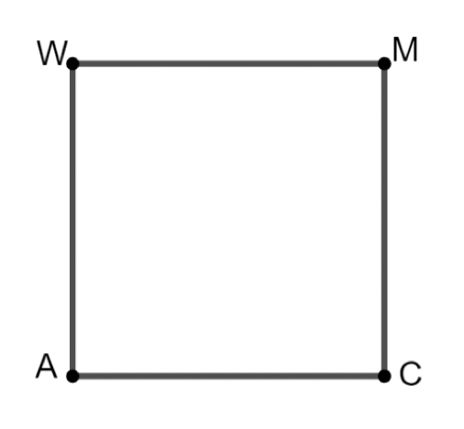

9.10.2 Exploration: Scale Factor and Area
Square $AWMC$ is shown, where $WM=1$ unit.
Determine the area of $AWMC$.
volume 2, pg. 105

Slide 9
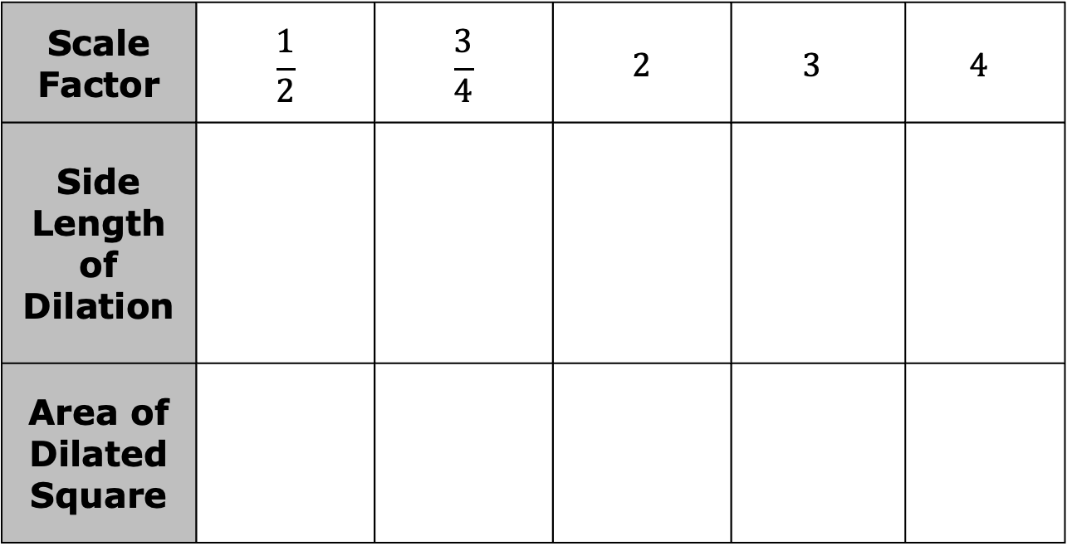
$AWMC$ is dilated using point $A$ as the center of dilation using each of the given scale factors. Complete the table.
Scale Factor | $$\frac{1}{2}$$ | $$\frac{3}{4}$$ | $$2$$ | $$3$$ | $$4$$
Side Length of Dilation
Area of Dilated Square
volume 2, pg. 105

Slide 10
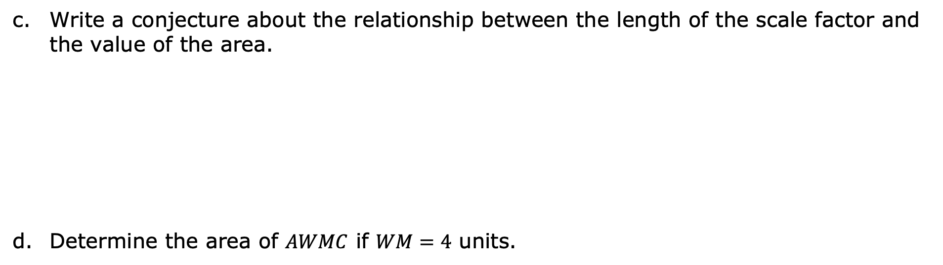
Write a conjecture about the relationship between the length of the scale factor and the value of the area.
Determine the area of $AWMC$ if $WM=4$ units.
volume 2, pg. 106

Slide 11
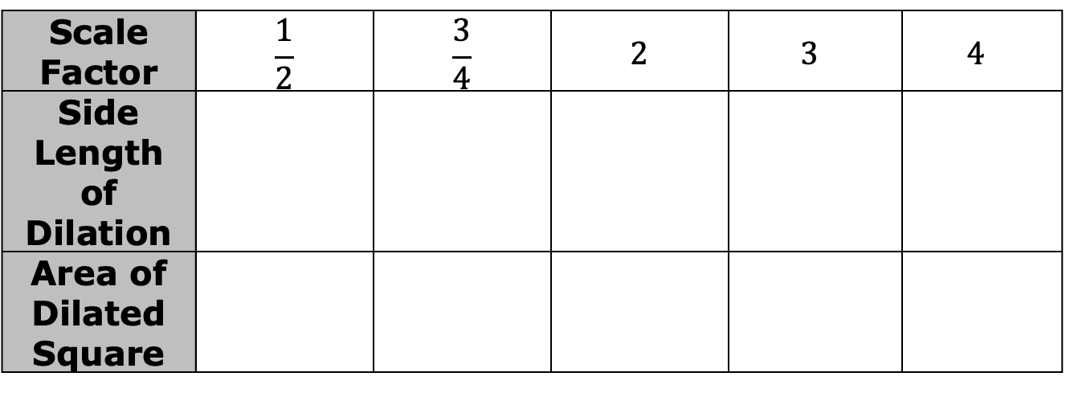

Suppose square $DTSC$ is dilated using point $D$ as the center of dilation for each of the given scale factors. Complete the table for $DTSC$ given that $TS=4$ units.
Review your conjecture from the previous problem and make any revisions, if needed.
Scale Factor | $$\frac{1}{2}$$ | $$\frac{3}{4}$$ | $$2$$ | $$3$$ | $$4$$
Side Length of Dilation
Area of Dilated Square
volume 2, pg. 106

Slide 12
Share your conjecture with your partner. Listen to your partner’s conjecture and write a summary. Have your partner initial that it is summarized correctly.
Review your conjecture and make any revisions, if needed.
Summary of Partner’s Conjecture | Partner’s Initials
volume 2, pg. 106

Slide 13
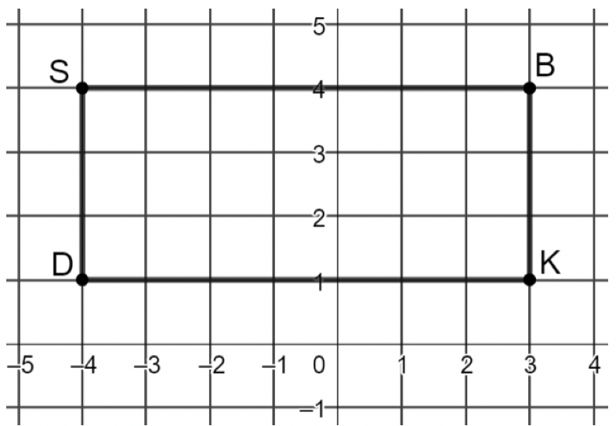

Rectangle $SBKD$ is shown.
Using the coordinate grid, find the area of the rectangle.
Area=_____ square units
volume 2, pg. 107

Slide 14
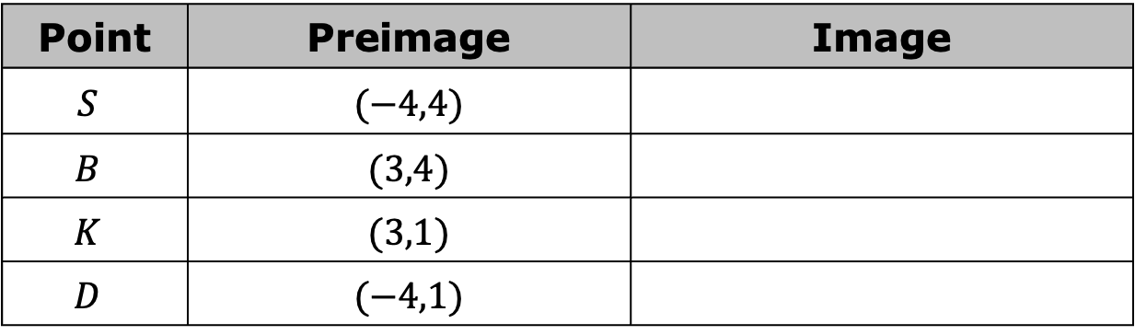
Dilate $SBKD$ by a scale factor of $3$ centered at the origin. Write the new coordinates in the table.
Point | Preimage | Image
$$S$$ | $$(−4,4)$$
$$B$$ | $$(3,4)$$
$$K$$ | $$(3,1)$$
$$D$$ | $$(−4,1)$$
volume 2, pg. 107

Slide 15
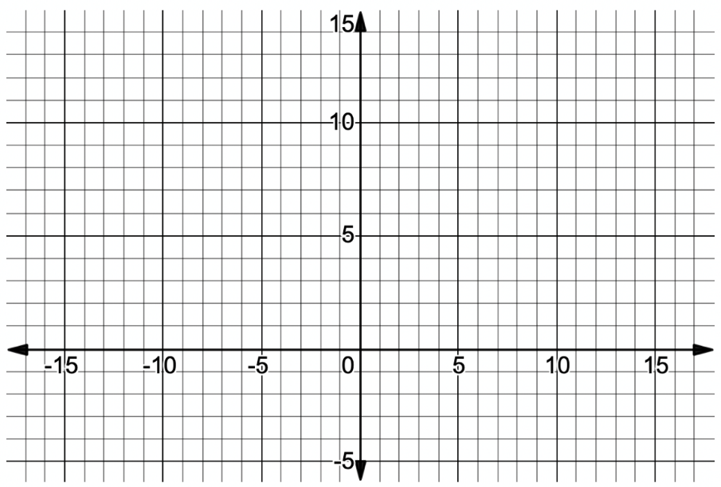

Graph $S′B′K′D′$ on the coordinate plane.
The area of rectangle $S′B′K′D′$ is _____ square units.
Does the conjecture you wrote about the relationship between area and scale factor when dilating a square hold true for rectangle $SBKD$?
volume 2, pg. 107

Slide 16
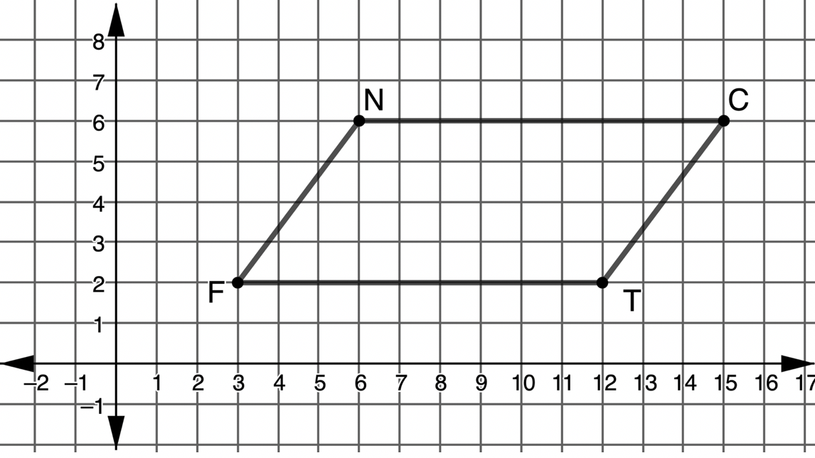

Parallelogram $FNCT$ is shown.
What is the area of $FNCT$, in square units?
volume 2, pg. 108

Slide 17
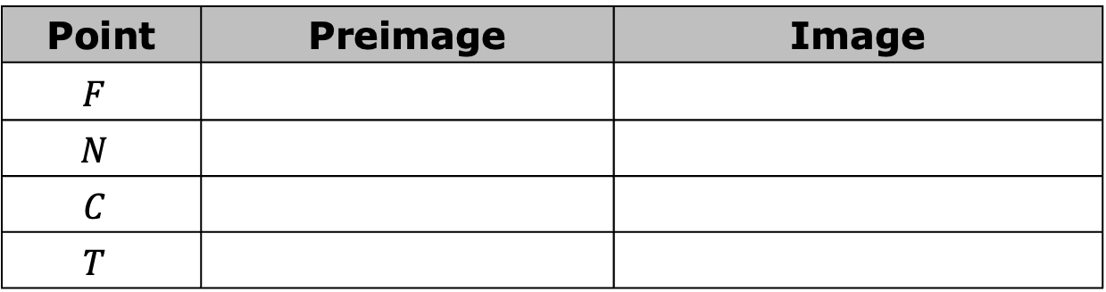
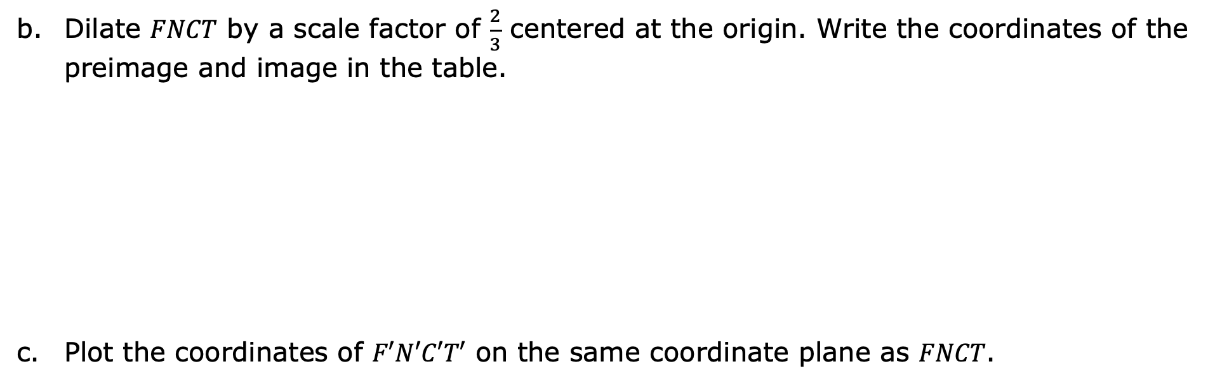
Dilate $FNCT$ by a scale factor of $\frac{2}{3}$ centered at the origin. Write the coordinates of the preimage and image in the table.
Plot the coordinates of $F′N′C′T′$ on the same coordinate plane as $FNCT$.
Point | Preimage | Image
$$F$$
$$N$$
$$C$$
$$T$$
volume 2, pg. 108

Slide 18
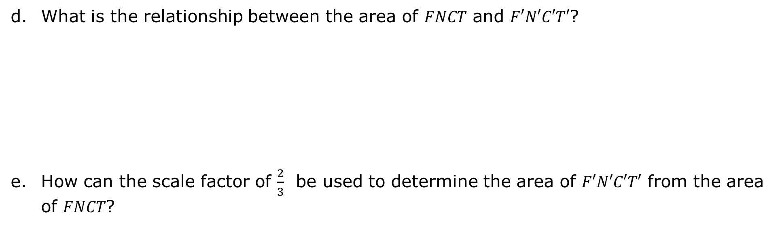
What is the relationship between the area of $FNCT$ and $F′N′C′T′$?
How can the scale factor of $\frac{2}{3}$ be used to determine the area of $F′N′C′T′$ from the area of $FNCT$?
volume 2, pg. 108

Slide 19

Guided Practice
volume 2, pg. 109

Slide 20

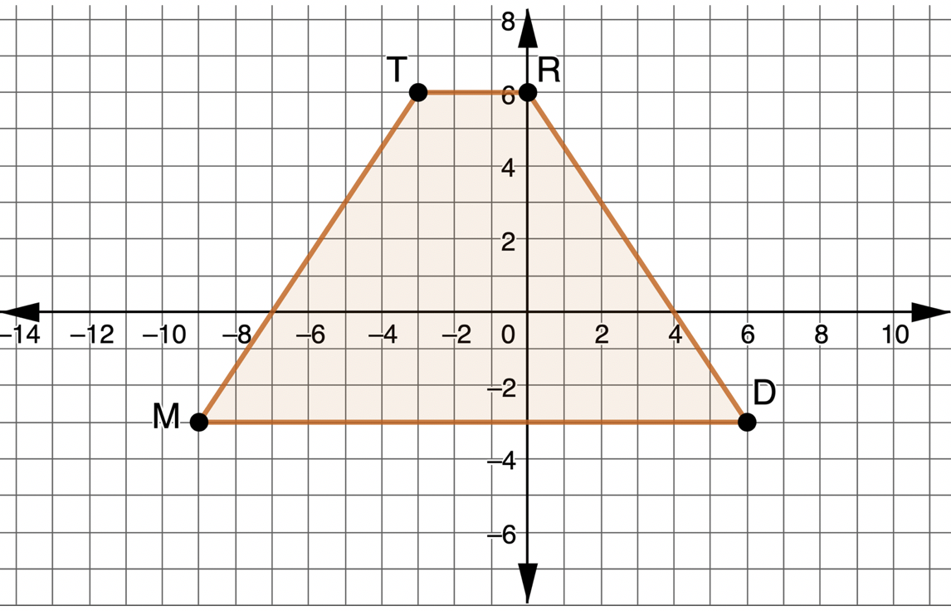
9.10.3 Guided Practice: Solving Problems Involving Scale Factor and Area
Trapezoid $MTRD$ is shown on the coordinate plane.
volume 2, pg. 109

Slide 21
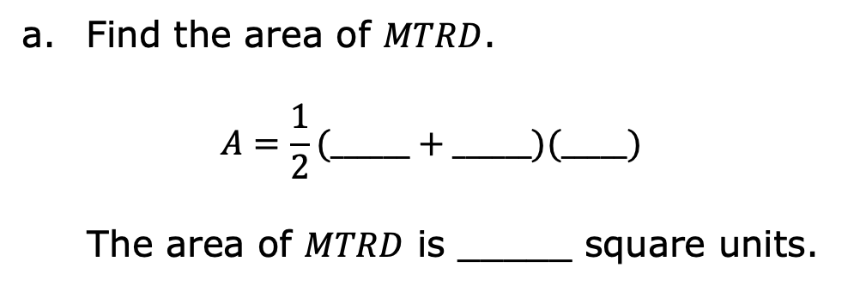
Find the area of $MTRD$.
$$A=\frac{1}{2}(______+______)(_____)$$
The area of $MTRD$ is _____ square units.
volume 2, pg. 109

Slide 22
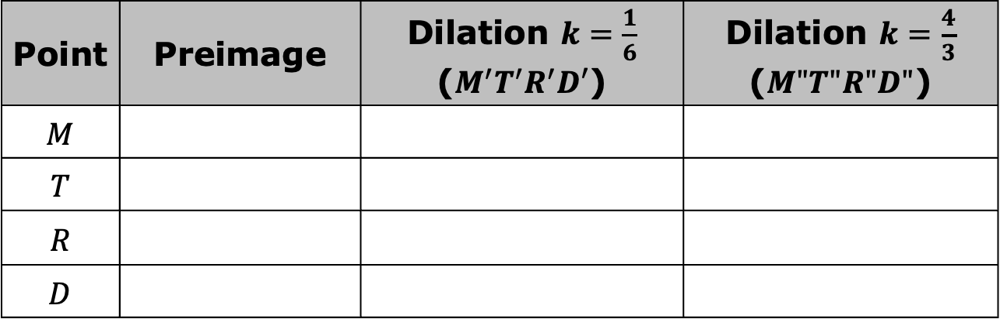

Find the coordinates of $MTRD$ given the scale factors in the table. Use the preimage coordinates to find the coordinates of the images. Both dilations are centered at $\left(0,0\right)$.
Find the area of $M′T′R′D′$.
What effects does the scale factor of $\frac{1}{6}$ have on the original area?
Point | Preimage | Dilation $k=\frac{1}{6}$ ($M^{′}T^{′}R^{′}D′$) | Dilation $k=\frac{4}{3}$ ($M"T"R"D"$)
$$M$$
$$T$$
$$R$$
$$D$$
volume 2, pg. 109

Slide 23
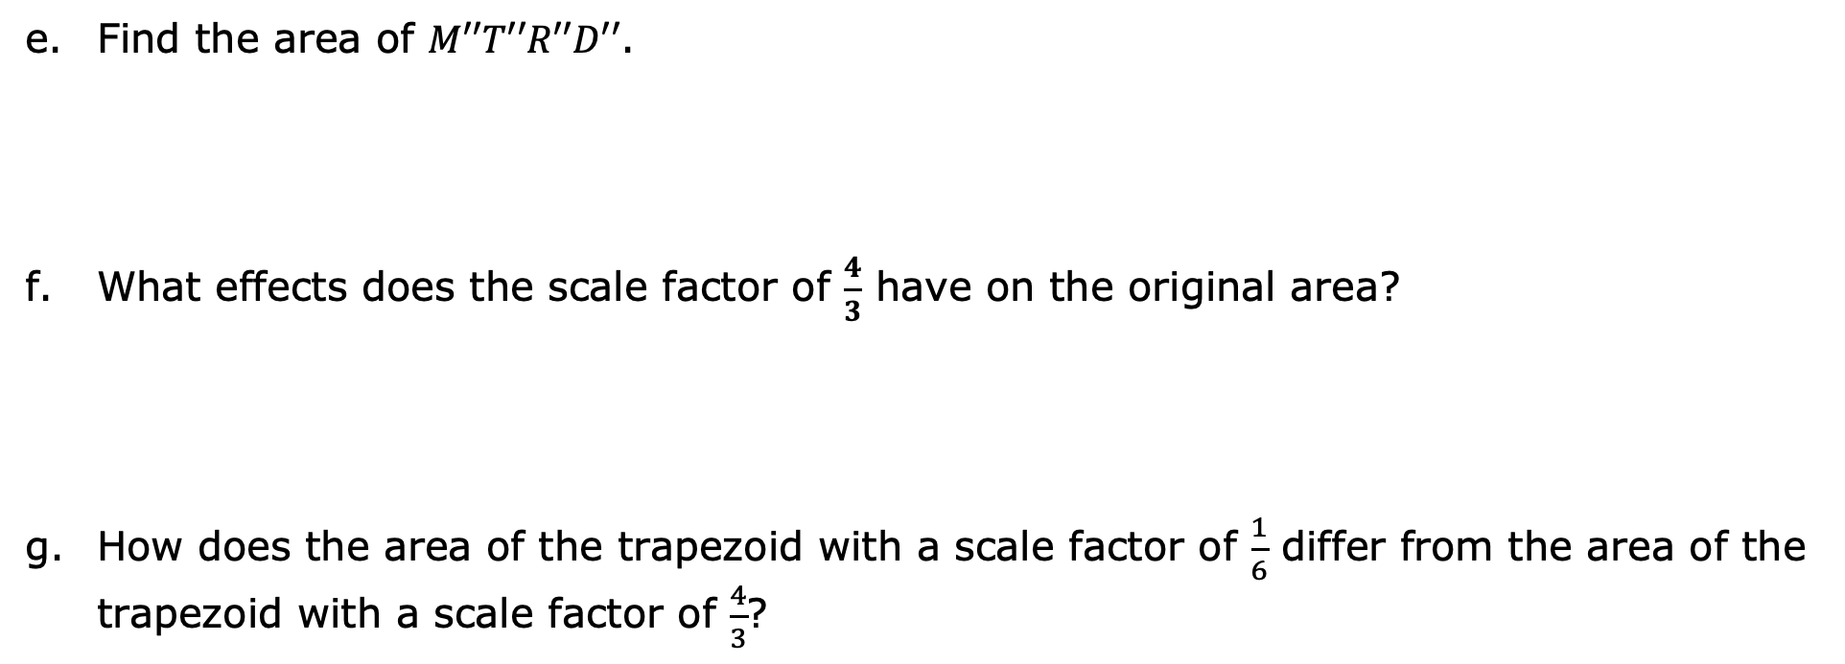
Find the area of $M′′T′′R′′D′′$.
What effects does the scale factor of $\frac{4}{3}$ have on the original area?
How does the area of the trapezoid with a scale factor of $\frac{1}{6}$ differ from the area of the trapezoid with a scale factor of $\frac{4}{3}$?
volume 2, pg. 110

Slide 24

Your Turn
volume 2, pg. 110

Slide 25
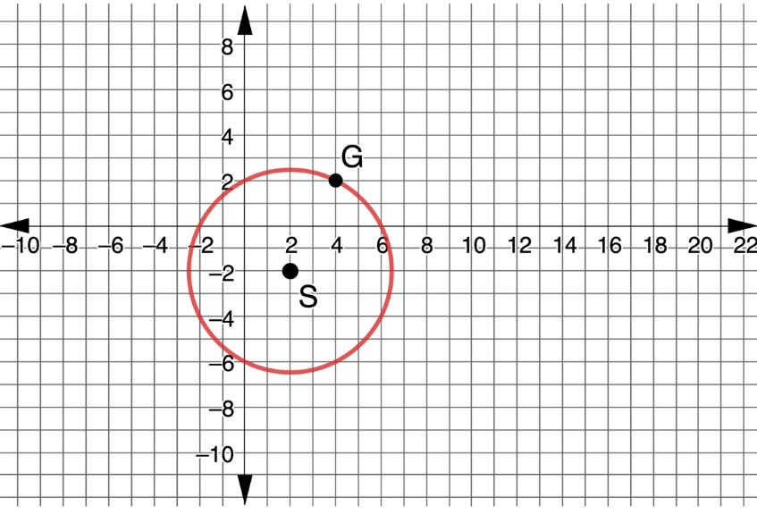

9.10.4 Your Turn!
Circle $S$ is shown with a radius of$\sqrt{20}$.
Dilate circle $S$ using a scale factor of $1.5$ centered at the origin, and graph the resulting image on the coordinate plane.
volume 2, pg. 110

Slide 26
Find the area of the circles.
Area of Preimage | Area of Image
volume 2, pg. 111

Slide 27

Wrap-Up
volume 2, pg. 111

Slide 28
9.10.5 Wrap-Up: Cool Down
Write an explanation to a classmate who might have missed today’s lesson, in your own words, about how dilations affect area.
volume 2, pg. 111

